Slide 1
Where to Build a Hotel in London

Slide 2
Introduction
London is the capital of the United Kingdom, and attracts 30 million visitors every year. Therefore, there is a huge hospitality industry in London. Imagine that you are an entrepreneur who owns a chain of upmarket hotels. You currently do not have a hotel in London, and you are trying to figure out the best place in London to open a hotel. We will use machine learning and data science techniques to solve this problem. Factors you may wish to consider:
• real estate price
• proximity to tourist sites
• whether or not there are already competitor hotels in the area

Slide 3
Data
From the web I found data regarding the average house price in each borough of London, which I will use as a proxy for the real estate price. I read this data into a CSV file called, which can be imported in the notebook. I will use the Foursquare API to gather data regarding proximity to tourist sites and competitor hotels.

Slide 4
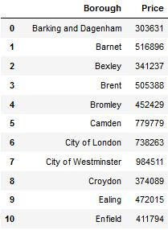
Price data of the boroughs

Slide 5
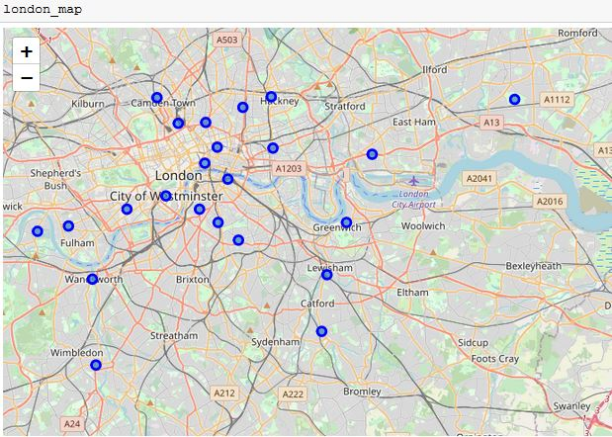
Map Generated using Folium showing the boroughs of London

Slide 6
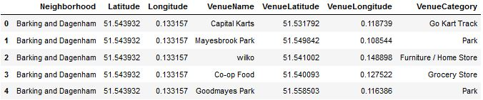
Using Foursquare API to generate info about nearby amenities in each area

Slide 8
Observations
The overwhelming majority of the tourist sites in London are concentrated near 'the square mile'. Therefore, despite this area of London being relatively expensive, I would recommend building the new hotel in that area.

